Slide 1

Mini project-I
ONLINE QUIZ GENERATOR
DEPARTMENT OF COMPUTER SCIENCE ENGINEERING AND APPLICATIONS
Institute Of Engineering and Technology

Slide 2
Submitted By:
Pratibha Dixit
(181500498)
And
Megha Kansal
(181500382)
Supervised By:
Mr. Anand Kumar Gupta
Asst. Professor
Department of Computer Science & Applications
And
Ms. Ruchi Gupta
Asst. Professor
Department of Computer Science & Applications

Slide 3
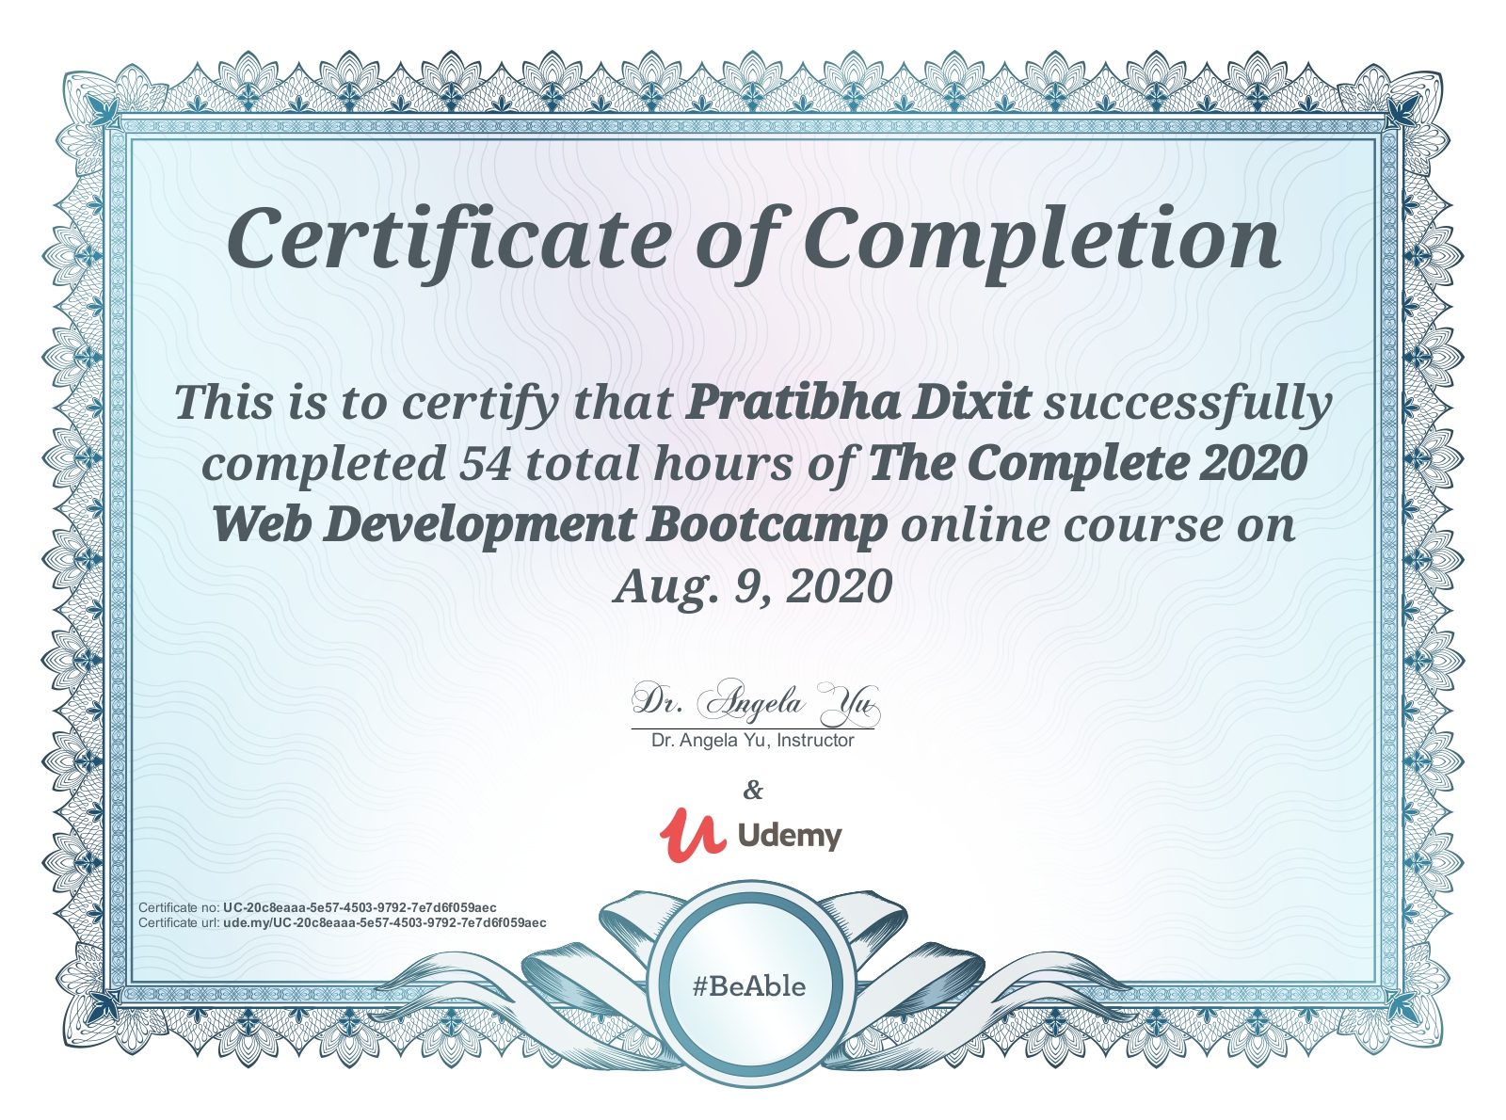
CERTIFICATES
1. Certificate of the Course attended by Pratibha Dixit:

Slide 4
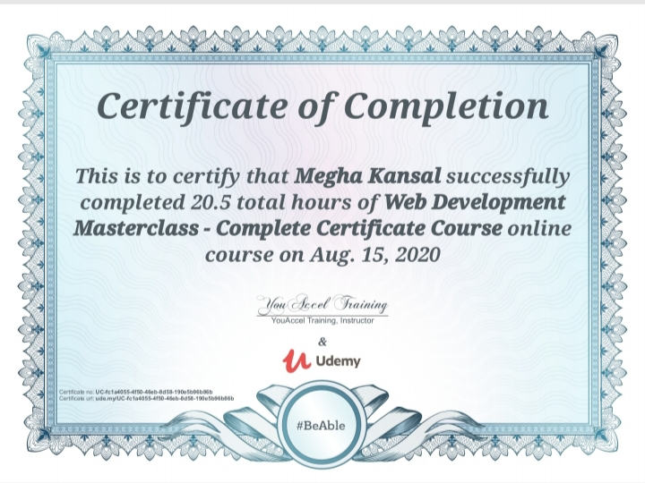
2. Certificate of the Course attended by Megha Kansal:

Slide 5
PROJECT
Online quiz generator

Slide 6
Introduction-
The “Online Quiz Generator” is a web application for taking online test in an efficient manner and no time wasting for checking and correction of paper.
Every admin has a user id and password to create and check marks of each quiz.
Every user has user id and password to attend a quiz.

Slide 7
Synopsis-
The main task of “Online Quiz Generator” is to efficiently evaluate a candidate thoroughly through a fully automated system that not only saves a lot of time but also gives fast results.
No restriction that examiner has to be present when the candidate takes test.
This web application can be used anywhere and at any time as it is a web based application (user location doesn’t matter).

Slide 8
Technologies Used-
PHP: PHP is a recursive acronym for "PHP: Hypertext Preprocessor". PHP is a server side scripting language that is embedded in HTML. It is used to manage dynamic content, databases, session tracking, even build entire e-commerce sites.
JavaScript:- JavaScript is a text-based programming language used both on the client-side and server-side that allows you to make web pages interactive. Where HTML and CSS are languages that give structure and style to web pages, JavaScript gives web pages interactive elements that engage a user.
Apache: Apache HTTP Server is a free and open-source web server that delivers web content through the internet. It is commonly referred to as Apache and after development, it quickly became the most popular HTTP client on the web.

Slide 9
SQL Server: The SQL Server is a relational database management system from Microsoft. The system is designed and built is to manage and store information. The system supports various business intelligence operations, analytics operations, and transaction processing.
CSS: CSS is used to define styles for your web pages, including the design, layout and variations in display for different devices and screen sizes.
Bootstrap: Bootstrap is a potent front-end framework used to create modern websites and web apps. It's open-source and free to use, yet features numerous HTML and CSS templates for UI interface elements such as buttons and forms. Bootstrap also supports JavaScript extensions.

Slide 10
Aim of this project-
With the effective use, any Institute can use the “Online Quiz Generator” for conducting quick examinations and getting better results in less time.
Apache Server Pages, MYSQL database used to develop this “Online Quiz Generator” application where all admins and students can login through the secured web page by their account login id and password.
We have developed a Web-based online test/quiz system which can create quizzes competitively and collaboratively for students for the purpose of reducing the load required for a teacher and promoting interaction among teachers and students.

Slide 11
ERD (Entity Relationship Diagram)-

Slide 12
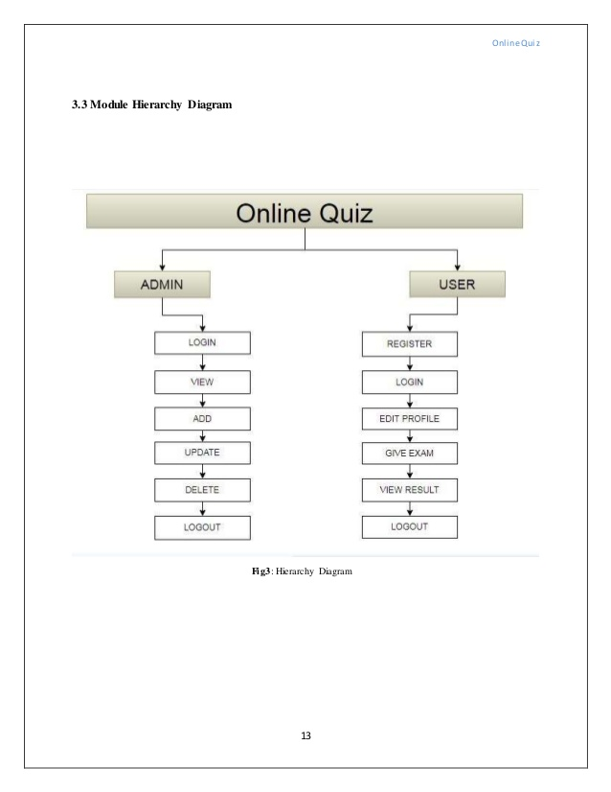
Model Hierarchy Diagram-

Slide 13
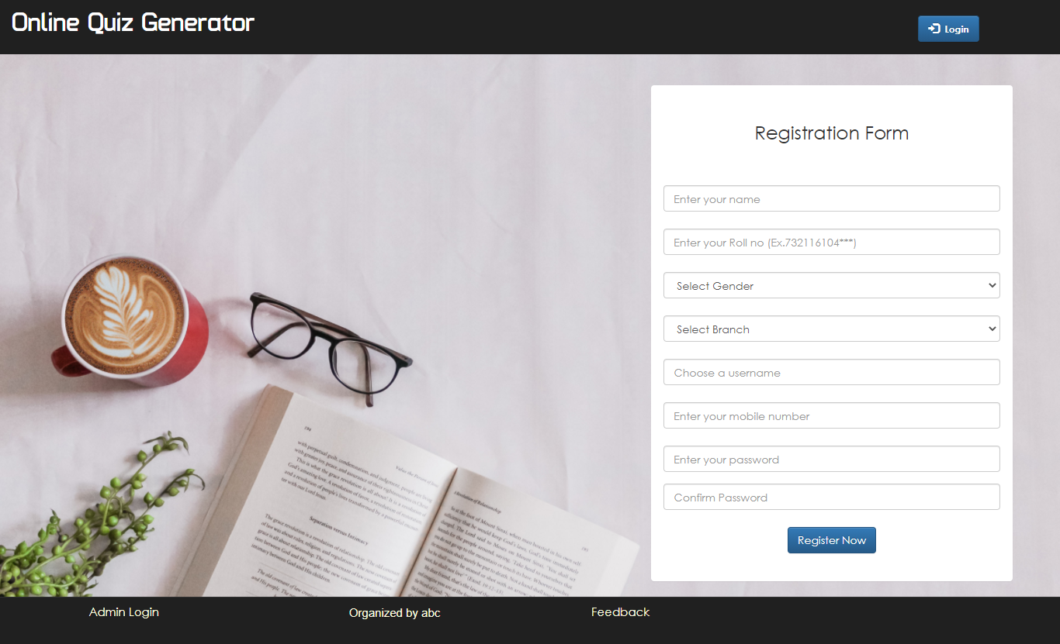
Screenshot Of The Front Page-

Slide 14
Benefits of Online Quiz Generator-
Online Quiz Generator is fast, secure, convenient and free.
Quick, simple, authenticated access to accounts via the web application.
Simply scalable to grow with changing system requirement.
Global enterprise wide access to information.
Improved data security, restricting unauthorized access.
Minimum storage space.

Slide 15
Conclusion-
This project is developed to nurture the needs of a user on an online environment by embedding all the tasks of assigning and completing quizzes on a single platform.
Future version of this software will still be much enhanced, than the current version 1.0, thus the “Online Quiz Generator”, is developed and executed successfully.

Slide 16
GitHub Repository Link for
Online Quiz Generator-
Link-1 to Pratibha Dixit’s repository:
Link: https://github.com/pratibhadixit3990/Mini-Project
Link-2 to Megha Kansal’s repository:
Link: https://github.com/meghakansal12/MiniProject-Online_Quiz_Generator
Note:
Both repositories contain complete source code. Hence you can use any one to get full Source code of the project.

Slide 17
References-
We referred to the following resources:
Course for Full-Stack Development on Udemy
1. Course Name: The Complete 2020 Web Development Bootcamp
Link:https://www.udemy.com/course/the-complete-web-development-bootcamp/
Attended By: Pratibha Dixit
2. Course Name: Web Development Masterclass- Complete Certificate Course
Link:https://www.udemy.com/course/web-development-masterclass-complete-certificate-course/
Attended By: Megha Kansal

Slide 18
Google Search
Our ongoing Full-Stack lectures and lab assignments
Website for Web-development: https://www.beta-labs.in/
YouTube videos

Slide 19
THANK YOU

